Slide 1
ENGI 301 Pocket-Copter Proposal
3rd October, 2018
Walker Grimes

Slide 2
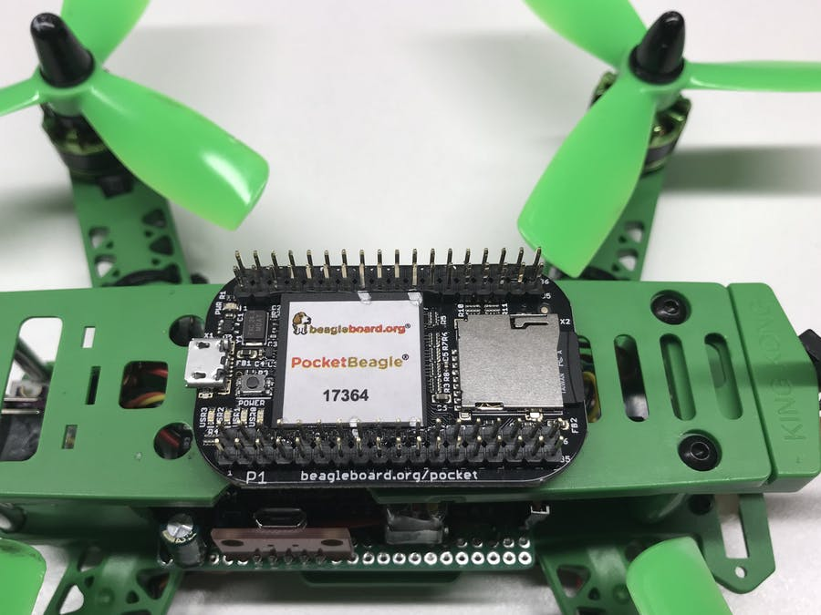
Background Information
I am proposing using the PocketBeagle as the control board for a small (180mm-210mm) Quadcopter
Quadcopters are well documented, but often use their own dedicated boards. I want to try to implement on a PB.
Major difference - Given time, I want to add GPS based positioning and ultrasonic range finding
https://www.hackster.io/patrickpoirier51/pocketpilot-an-autopilot-based-on-the-25-pocketbeagle-1fa14b
Fig 1: Pocket Pilot

Slide 3
System Block Diagram
HC-SR04 Rangefinder
PocketBeagle
DYS 20A 4 in 1 ESC w/BEC
Trig (in)
P2-2 (out)
Echo (out)
P2-4 (in)
Accel/GyroMPU6050
pwm(P1-33)
Motor 1
pwm(P1-36)
Motor 2
SCL(P2-9)
pwm(P2-1)
Motor 3
SDA(P2-11)
pwm(P2-3)
Motor 4
SCL
SDA

Slide 4
Power Block Diagram
(Potentially get rid of this PDB)
OCDay 3A PDB
1300mah,14v, 4s Lipo Dynogy Battery
Vin
+
HC-SR04 Rangefinder
-
All 3 phase 20A connections
5V, 15 mA Vcc
Gnd
Gnd
4s Vout
Gnd
M1
PocketBeagle
M1
5V, 15 mA Vout(P2-13)
DYS 20A 4 in 1 ESC w/BEC
Gnd(P2-15)
4s Vin
Gnd
Vout 5v,3A BEC
5V,3A Vin(P1-1)
M2
Gnd
M2
Accel/GyroMPU6050
Gnd(P1-24)
3.3V, 300μA Vdd
Gnd
Motor 1
M3
3.3V, 300μA Vout (P1-14)
M3
Gnd(P1-16)
Motor 2
Motor 3
Motor 4
M4
M4
BR2205 Motors

Slide 5
Components / Budget
Component | Need to Buy | Cost (USD)
Frame | 1 | 25
Motors | 4 | 28
DYS 20 A 4 in 1 esc w BEC | 1 | 40
Pocket Beagle | 0 | N/A
OCDAy 3A Power distribution board | 1 | 10
MPU6050 | 1 | 6
Dinogy 1300mah battery | 1 | 23
Propellers | 4 | 5
Ultrasonic Rangefinder HC-SR04 | 0 | N/A
TOTAL |  | 137

Slide 6
Potential Enhancements

